Slide 1
CAPSTONE PROJECT REPORT
Modelling, simulation, and control of assisting motor and control rules of Electric Powered Steering (EPS) system
Instructors: Ph.D Ngô Đắc Việt
Ph.D Trần Đăng Long
Student: Đặng Minh Duy - 1910933

Slide 2
TABLE OF CONTENTS
INTRODUCTION
THEORETICAL BASIS
SIMULATION PROCESS
RESULTS AND EVALUATION
FUTURE WORK AND ENHANCEMENT

Slide 3
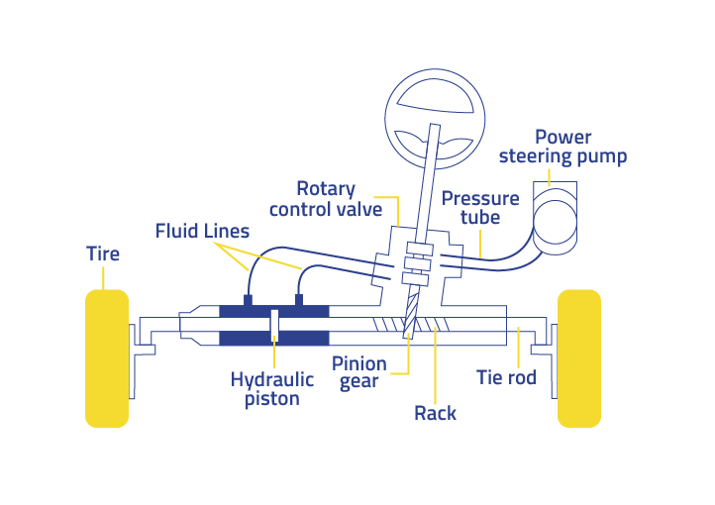
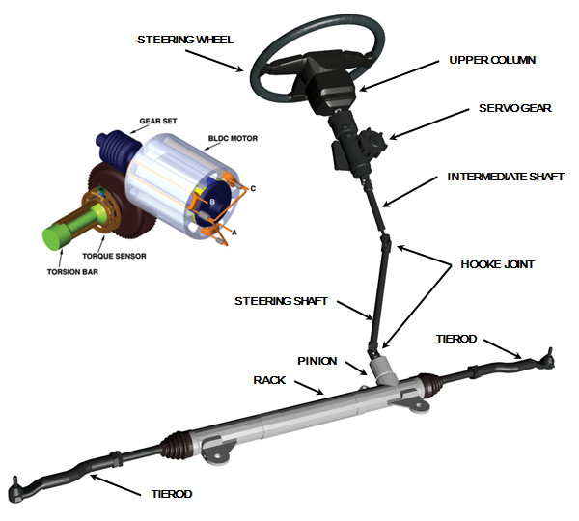
1.INTRODUCTION 1.1.Introduction to power steering system
Electric power steering is lighter, more compact. It also requires less maintenance, has better fuel efficiency

Slide 4
1.INTRODUCTION 1.1.Introduction to power steering system
Objective: Build and simulate the Electric power steering system and apply the control rules according to different steering wheel angles and speeds of vehicle.

Slide 5
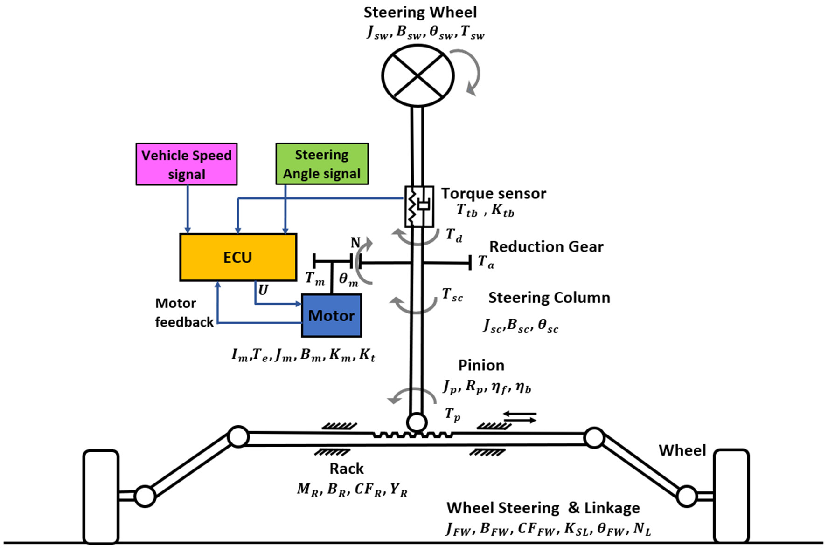
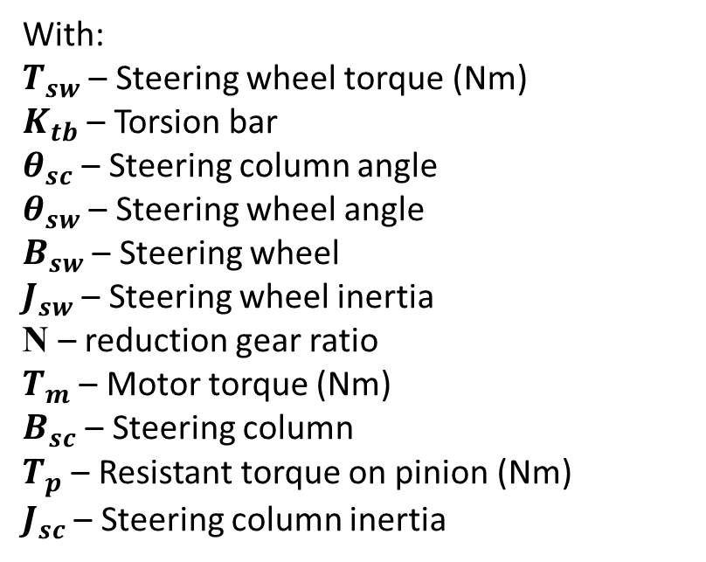
2. THEORETICAL BASIS 2.1. Dynamic equilibrium equation
$T_{sw}$ - $K_{tb}(θ_{SC}−θ_{SW}$)-$B_{sw}{\dot{θ}}_{sw}$ - $J_{sw}{\ddot{θ}}_{sw}$ + N. $T_{m}$ - $B_{sc}{\dot{θ}}_{sc}$ - $T_{p}$= $J_{sc}{\ddot{θ}}_{sc}$
With:
$T_{sw}$ – Steering wheel torque (Nm)
$K_{tb}$ – Torsion bar
$θ_{sc}$ – Steering column angle
$θ_{sw}$ – Steering wheel angle
$B_{sw}$ – Steering wheel
$J_{sw}$ – Steering wheel inertia
N – reduction gear ratio
$T_{m}$ – Motor torque (Nm)
$B_{sc}$ – Steering column
$T_{p}$ – Resistant torque on pinion (Nm)
$J_{sc}$ – Steering column inertia

Slide 6
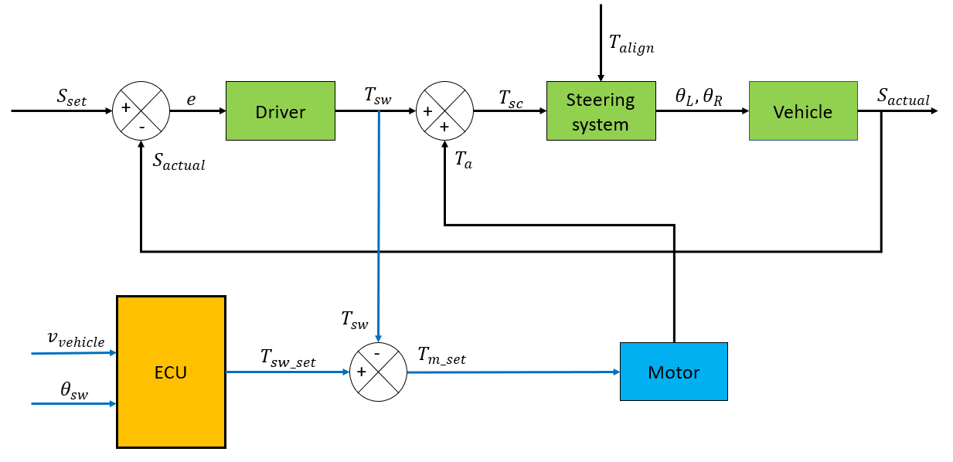
2. THEORETICAL BASIS 2.2. ELECTRIC POWER STEERING (EPS) BLOCK DIAGRAM

Slide 7
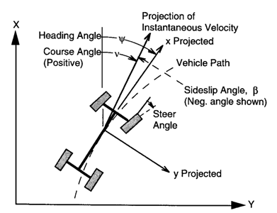
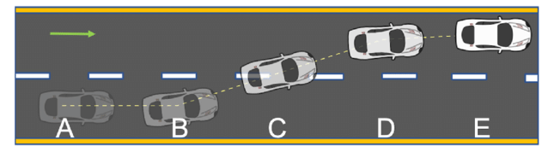
3. SIMULATION PROCESS 3.1 CREATING A PATH

Slide 8
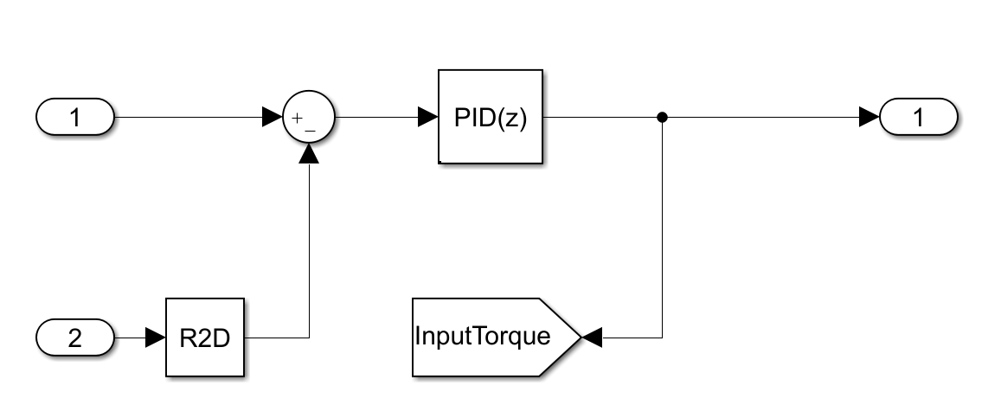
3. SIMULATION PROCESS 3.2 SIMULATION OF A DRIVER

Slide 9
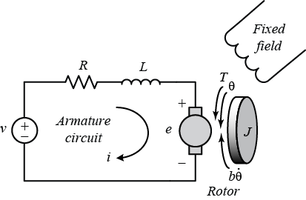
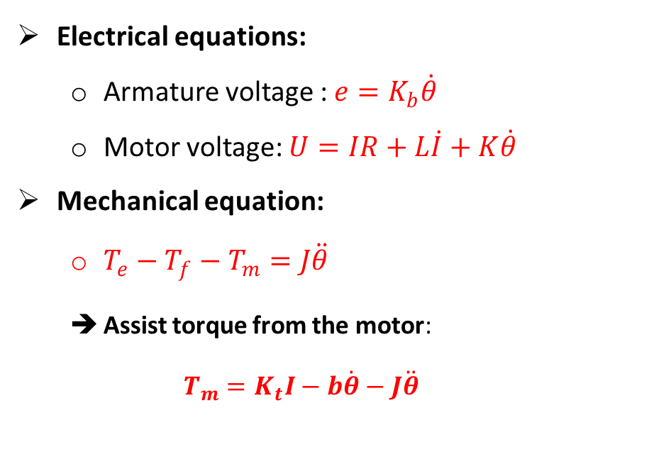
3. SIMULATION PROCESS 3.3. DC MOTOR MODEL
Electrical equations:
Armature voltage : $e=K_{b}\dot{θ}$
Motor voltage: $U=IR+L\dot{I}+K\dot{θ}$
Mechanical equation:
$T_{e}−T_{f}−T_{m}=J\ddot{θ}$
Assist torque from the motor:
$$T_{m}=K_{t}I−b\dot{θ}−J\ddot{θ}$$

Slide 10
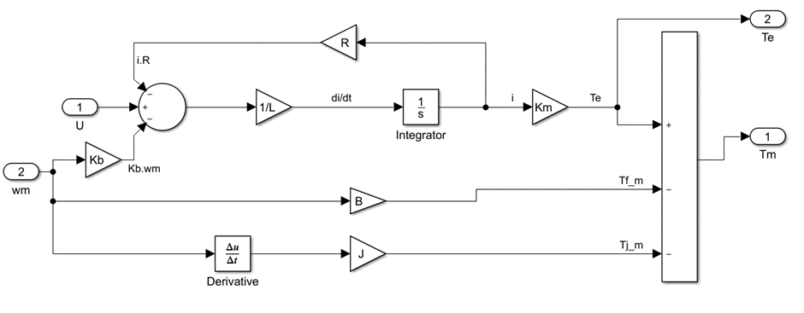
3. SIMULATION PROCESS 3.3. DC MOTOR MODEL

Slide 11
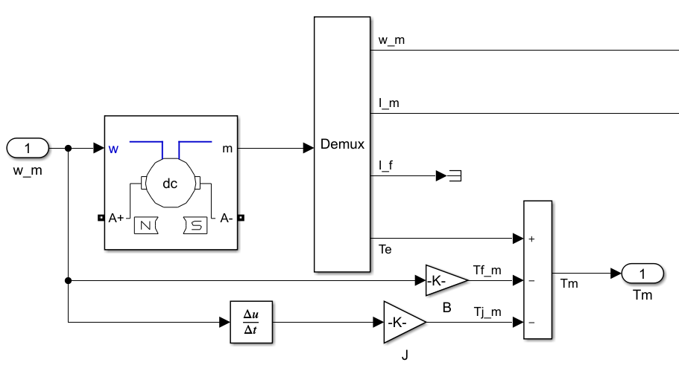
3. SIMULATION PROCESS 3.3. DC MOTOR MODEL

Slide 12
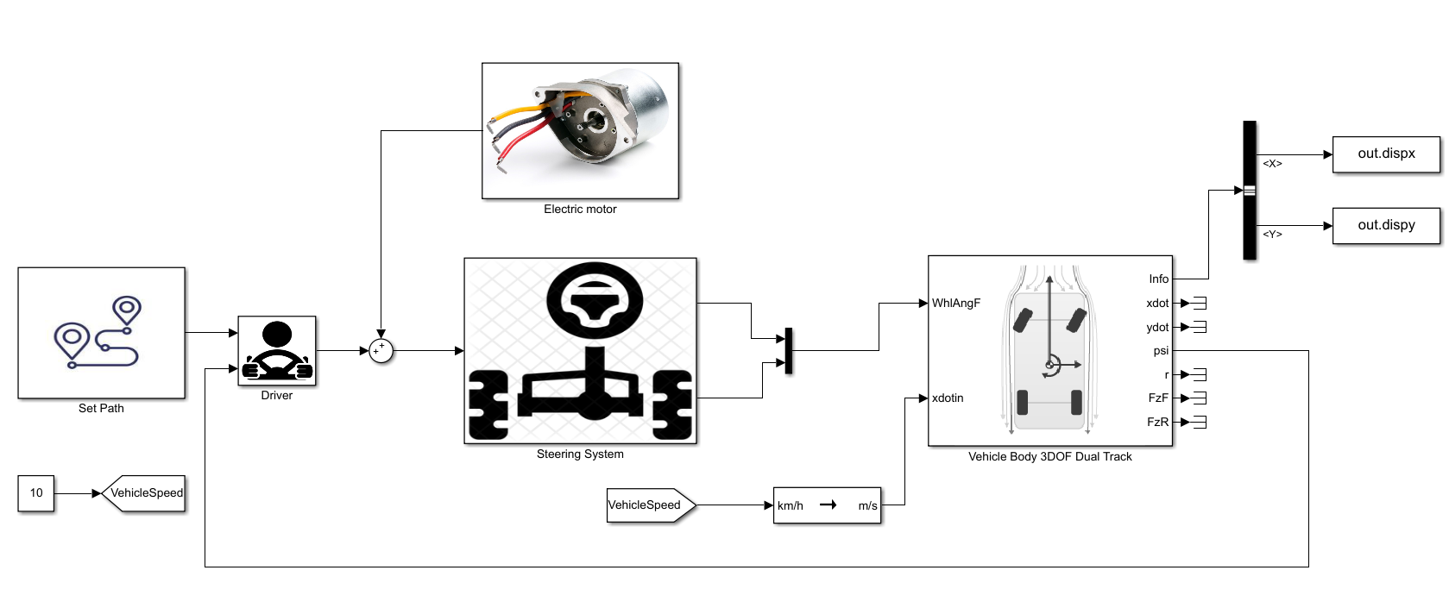
3. SIMULATION PROCESS 3.4. COMPLETE SIMULATION MODEL

Slide 13
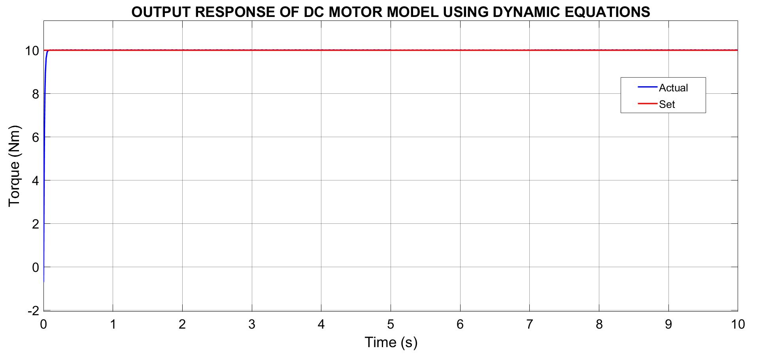
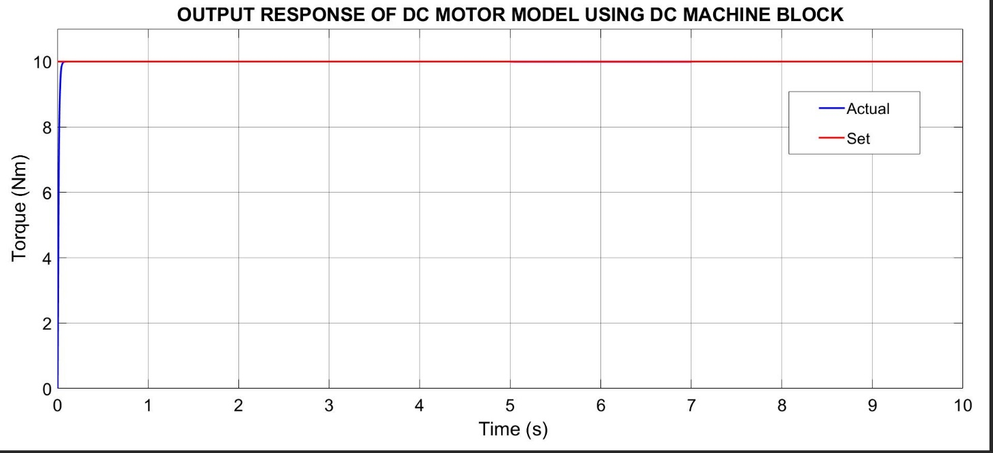
4. RESULT AND EVALUATION 4.1. OUTPUT RESPONSE OF DC MOTOR
➔ Both models give out the same results ➔ Both models are correct

Slide 14
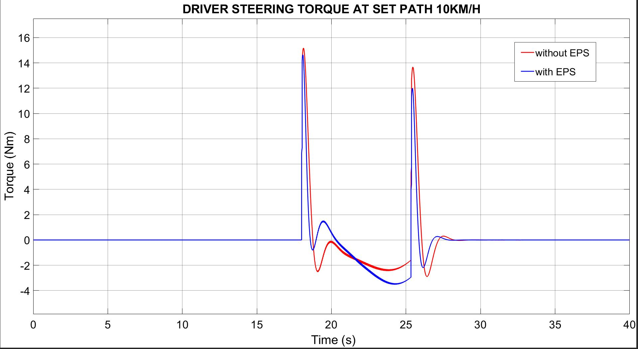
4. RESULT AND EVALUATION 4.1. AT 10KM/H

Slide 15
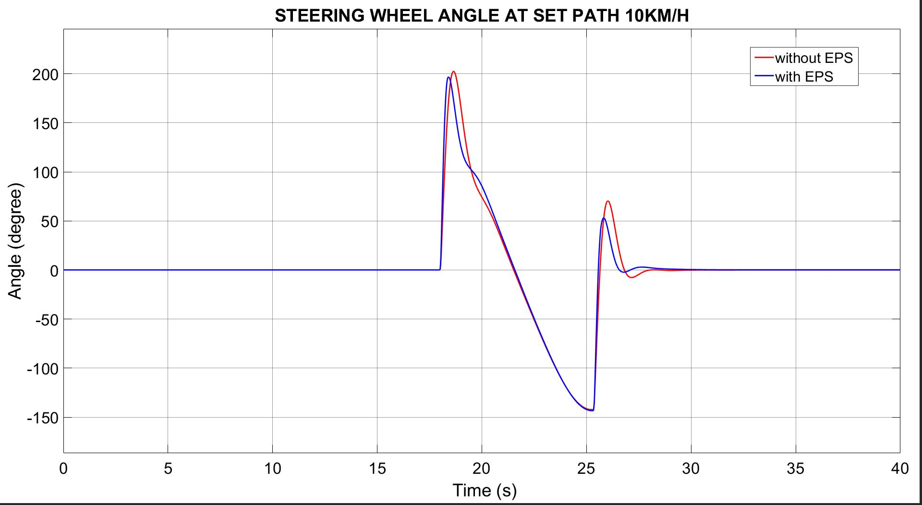
4. RESULT AND EVALUATION 4.1. AT 10KM/H

Slide 16
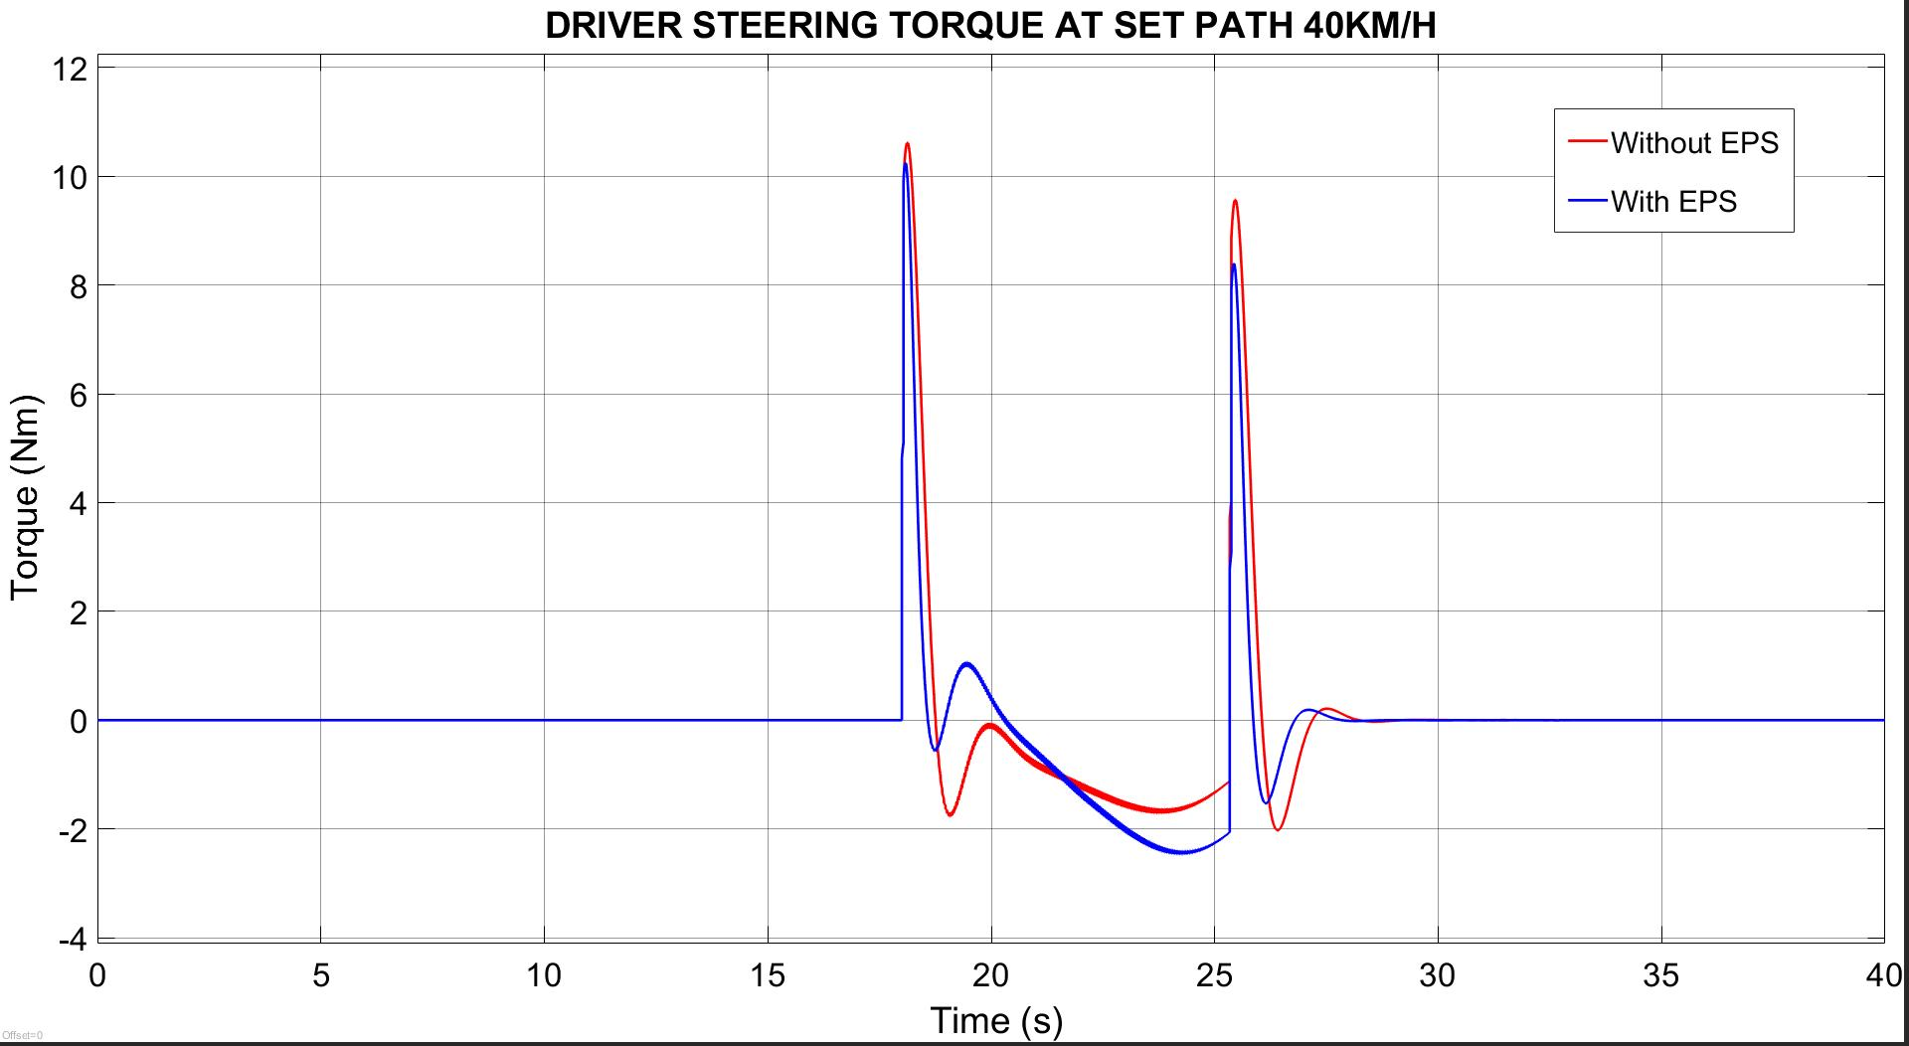
4. RESULT AND EVALUATION 4.1. AT 40KM/H

Slide 17
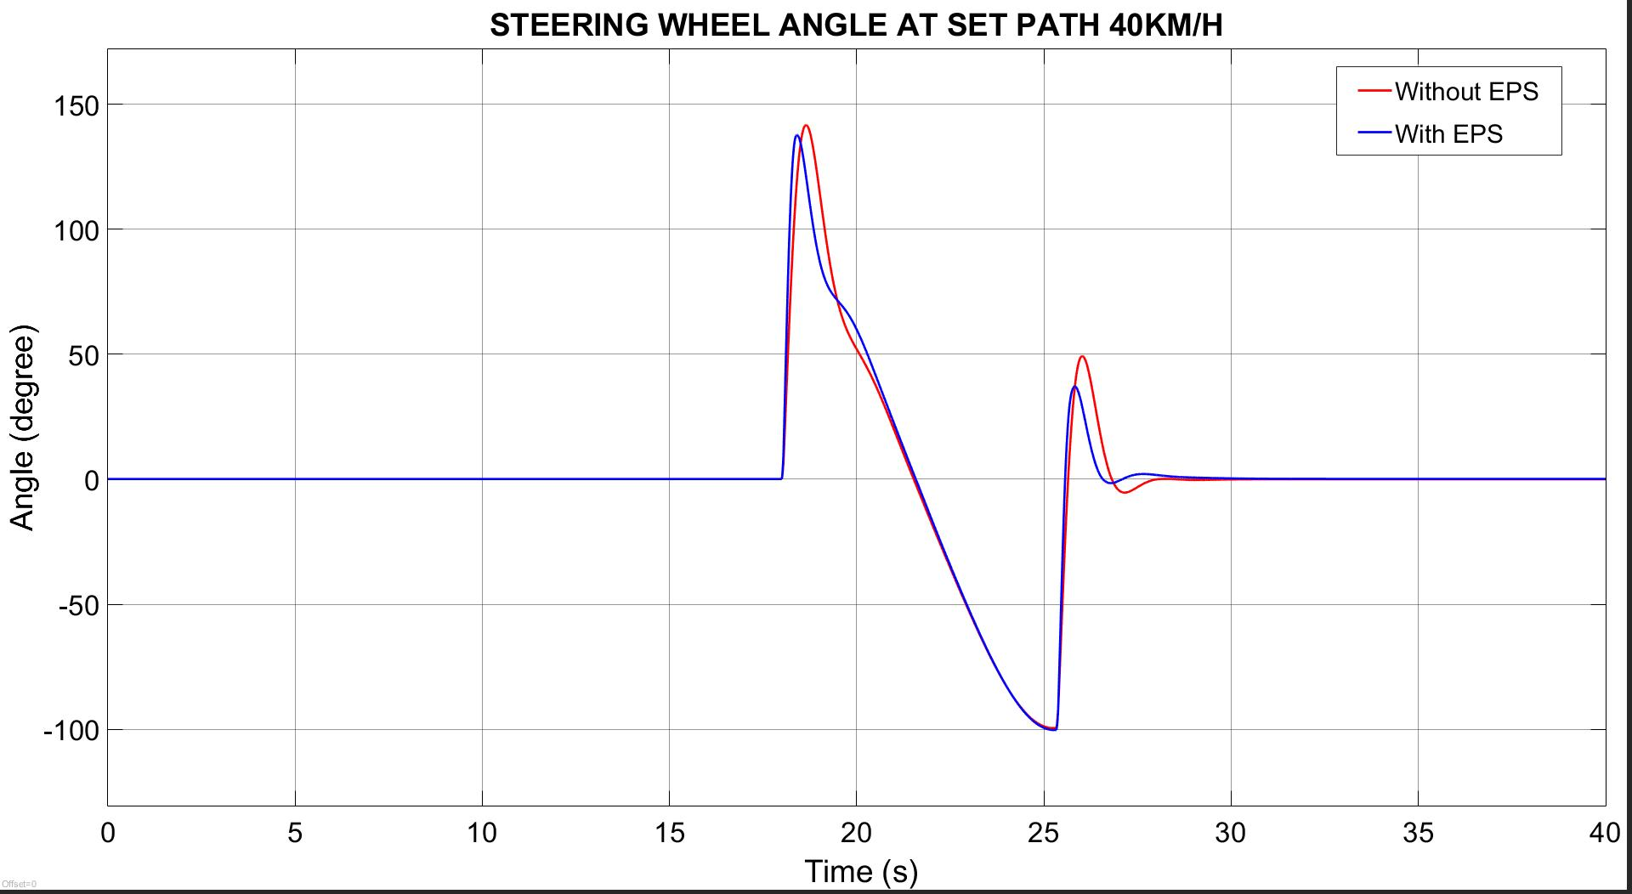
4. RESULT AND EVALUATION 4.1. AT 40KM/H

Slide 18
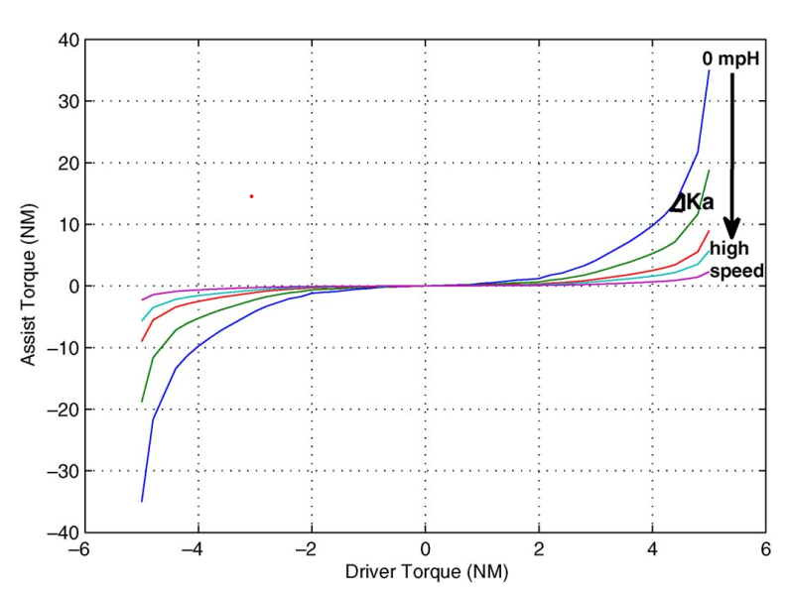
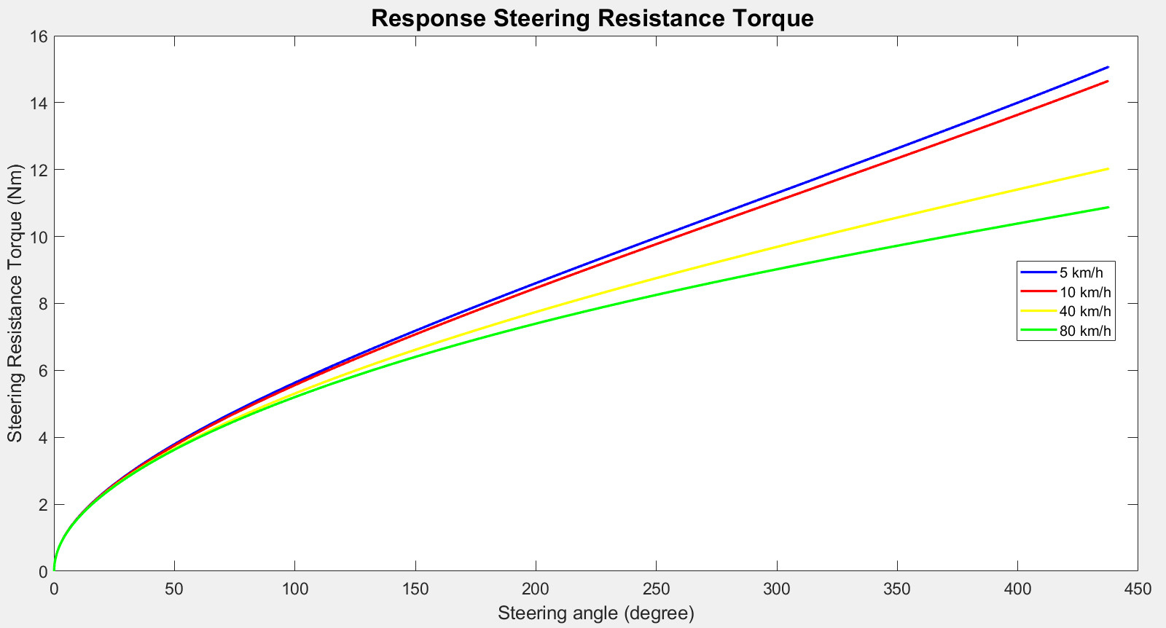
5. CONCLUSION
Project’s control rules
A New Control Strategy of an Electric-Power-Assisted Steering System

Slide 19
6. FUTURE WORK AND ENHANCEMENT
Enhance the accuracy and realism of the simulation model by incorporating data from real-world driving scenarios and testing conditions.
Improve the predictive capabilities of the model, allowing for more accurate and reliable simulations of different driving scenarios.
Develop new control rules and algorithms for EPS systems could help to further optimize the performance and efficiency of these systems

Slide 20
THANKS FOR YOUR ATTENTION!

